Slide 1
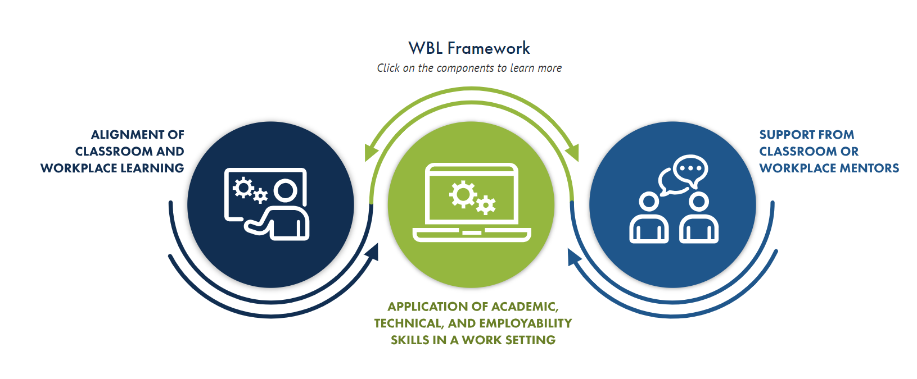

Work-Based Learning (WBL) Update
The alignment of classroom and workplace learning; application of academic, technical, and employability skills in a work setting; and support from classroom or workplace mentors.

Slide 2
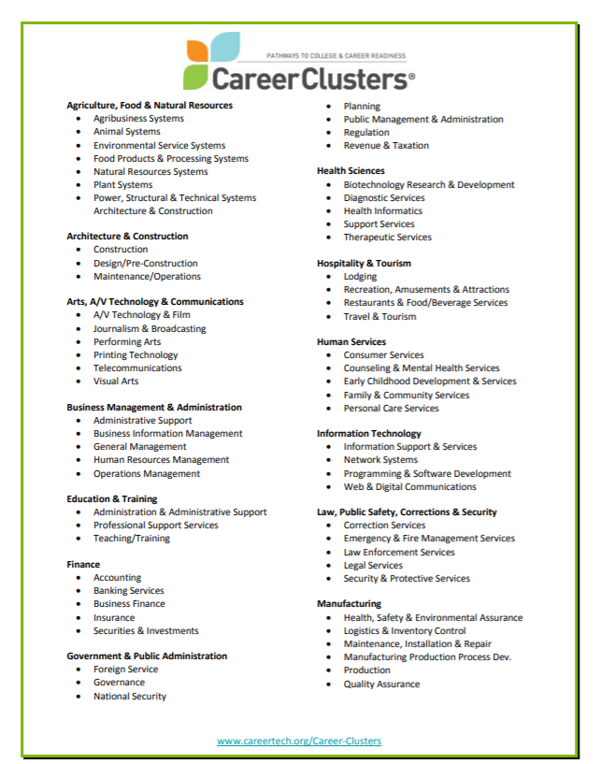
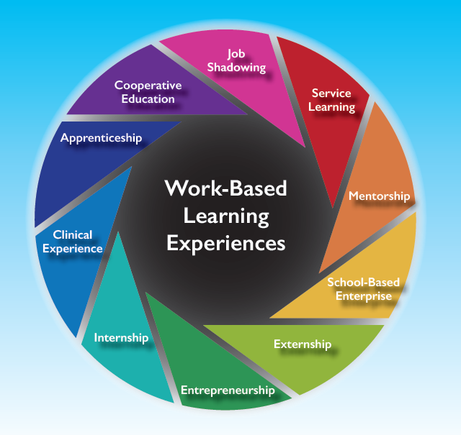
Career Frameworks
Career Clusters & Pathways
WBL Experience Options
Notes:
Not just the traditional internship model

Slide 3
WBL Focus 2019-2020
Integration & Centralization
Industry & Community Partnerships
Operations

Slide 4

WBL Integration & Centralization
Integrate WBL into each school’s ecosystem to grow engagement.
Career & Academic Counseling
CTE Curriculum with WBL options
9-12 Grade Seminars
Academies/Centers - CATEC, Center 1, HMSA, MESA, ESA
Independent Study/Capstone Project options
Centralized WBL Career Resource Library
WBL Campaign - Career & Continuing Education/Training
Explore careers and gain experience to direct your next move after high school.
Kroger Foods - Top 25 HS Internships
Notes:
Reaching all student demographics to assure equity and access to WBL.
CATEC as a best-practice leader.

Slide 5
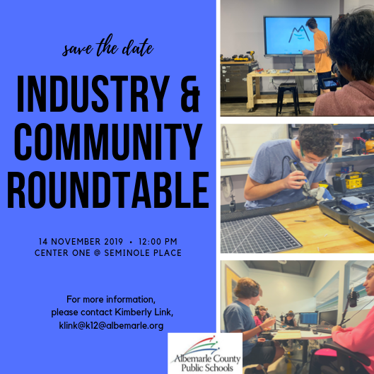
WBL Industry Partnerships
Engage employers/community organizations to establish a future talent pipeline through partnership.
Contribute industry perspective to career readiness initiatives
Develop WBL Experiences for students
Invest in talent pipeline state incentives
(i.e. Youth Registered Apprenticeships)
Mentor students
Participate in Career Cluster events
Tuesday, December 10th, 8:00-9:30 am
Center 1, One Seminole Place
Notes:
Industry & Community Roundtable, December 12th
Partnership development with a unified approach with CATEC, CCS, PVCC etc.

Slide 6
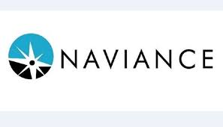

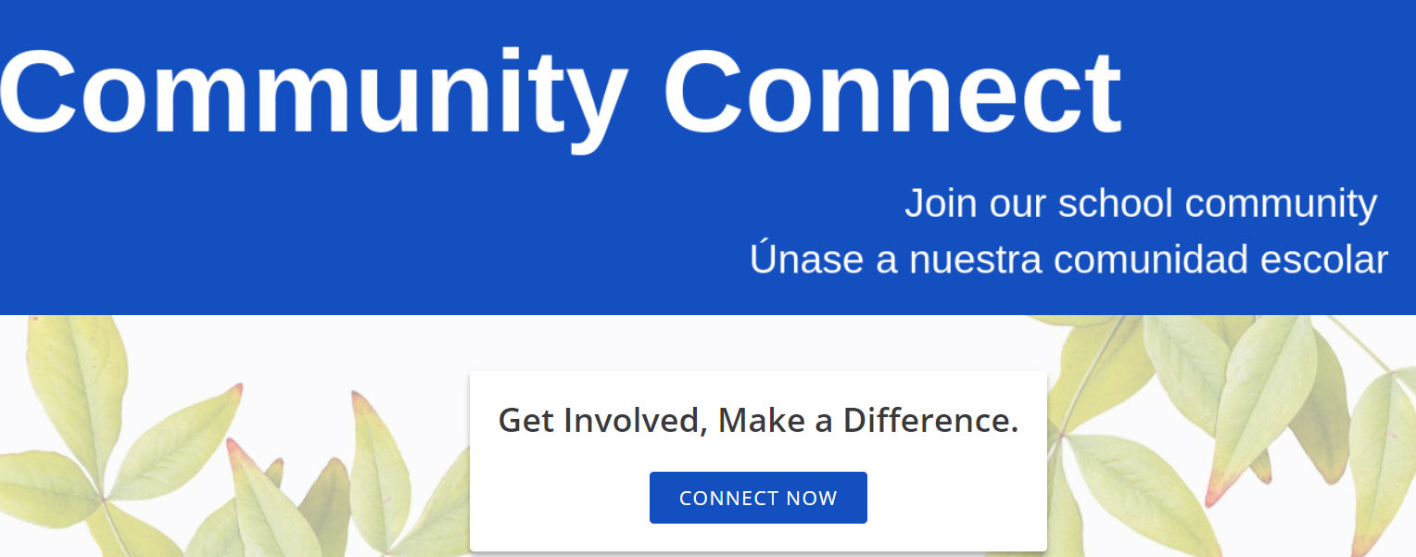
WBL Operations
Career Readiness
9th-12th Scope & Sequence
Career Assessment & Advising
Reporting & Tracking
Connecting Employers & Students
Industry Partnerships by Career Cluster
WBL Experience Postings
Youth Registered Apprenticeships
Event & Volunteer Management
Career Cluster Programs
Speaker Series
Mentorship
Notes:
Developing these three systems to grow WBL.

Slide 7




Student Perspectives

Slide 8

Questions/Further Discussion
Notes:
How can the Board help?
To reach all students, we need to build WBL opportunities with consolidation and collaboration with other schools/programs that do this work well (CATEC, HMSA, City of Cville). Be an advocate for serving students in the County as a subset of all students so there is a unified voice with employers in the region.

